Slide 1
Product Catalog Management System
Logger

Slide 2
Team Members
Team Name | Members | Project Name | Project Technologies
PSA | Prabhat Rawat (21BTCSE0147) | Product Catalog Management System | Core Java File Handling(.dat file) Console-based Application Error Handling
 | Adarsh Rawat (21BTCSE0272)
 | Satyam Pal (21BTCSEAI0035)

Slide 3
Introduction
The Product Catalog Management System is a console-based application developed in Core Java, designed to handle the management of a product inventory. It leverages file handling, console I/O, error handling, sorting and purchase simulation techniques to provide a robust solution for maintaining and organizing products.
This project ensures that product data is stored persistently in a file, enabling data retrieval even after the program is restarted. It features a simple and intuitive workflow with user authentication to restrict access to authorized users only.

Slide 4
Key Features
User Authentication:
Admin: Has full access to all functionalities, including adding, updating, deleting products, and viewing, sorting, and searching the catalog.
Regular User: Can view, search, and purchase products from the catalog.
Product Management:
Add Product: Admins can add new products to the catalog, ensuring no duplicates based on product name and category.
View Products: All users can view the list of products in the catalog.
Update Product: Admins can update the details of existing products.
Delete Product: Admins can remove products from the catalog.

Slide 5
Key Features
Search and Sort:
Search Product: Users can search for products by name or subsequence.
Sort Products: Admins can sort products by name (ascending/descending) and by price (ascending/descending).
Purchase Simulation:
Regular users can simulate purchasing products, where the product's quantity is updated based on the purchase.

Slide 6
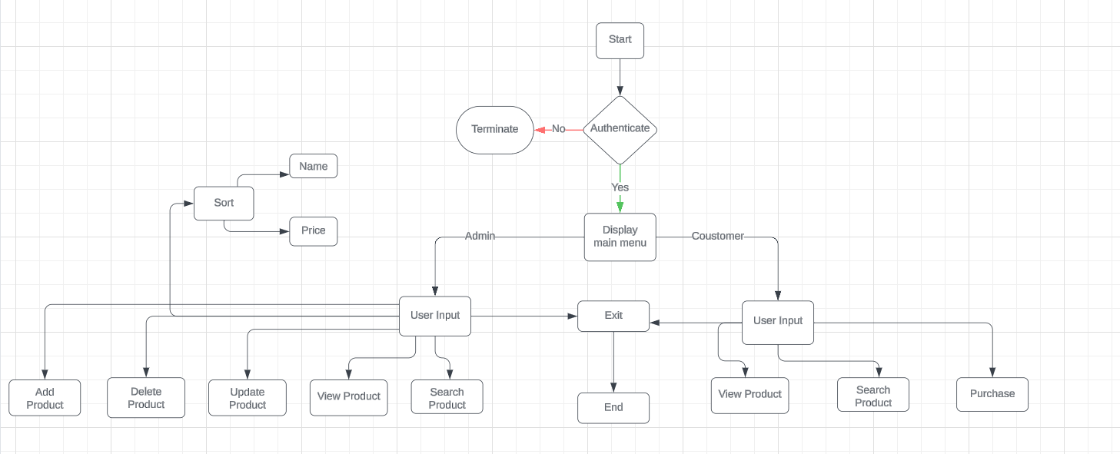
Main Application Workflow

Slide 7
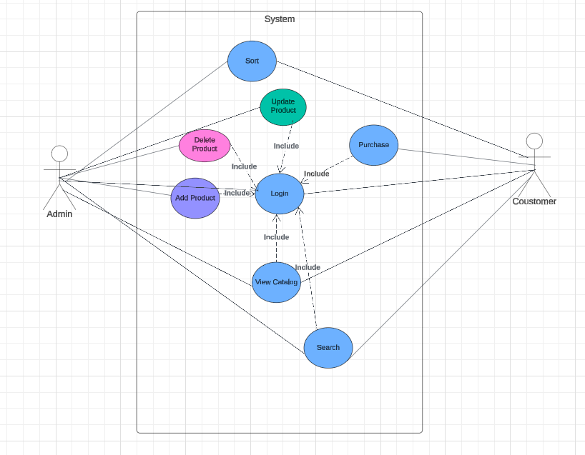
Use Case Diagram

Slide 8
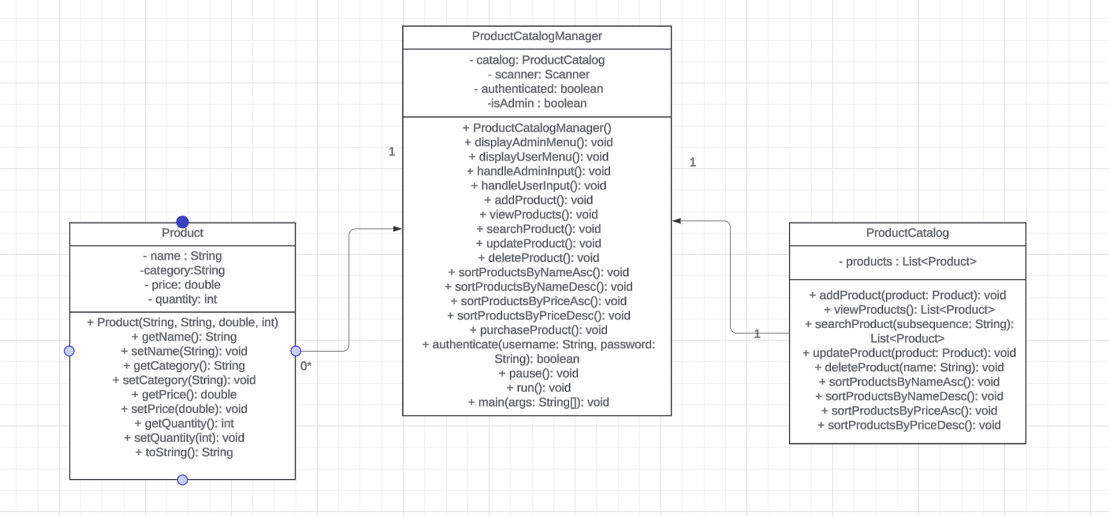
Class Diagram

Slide 9
Explanation Of Class Diagram
This class diagram shows the relationships and interactions between the classes, illustrating the structure and functionality of the Product Catalog Management System.

Slide 10
Product Class
Represents a product with attributes such as name, category, price, and quantity.
Provides getter and setter methods for each attribute.
Includes a `toString` method for easy representation of product details.

Slide 11
ProductCatalog Class
Manages a collection of `Product` objects.
Provides methods to add, view, search, update, delete, and sort products.
Uses file handling to save and load product data to/from a file.
Includes a method to check for duplicate products.

Slide 12
ProductCatalogManager Class
Provides the main user interface for interacting with the product catalog.
Handles user input and directs actions to the `ProductCatalog` class.
Manages user authentication to ensure only authorized users can access the catalog.
Provides methods to display a menu, handle user input, and perform various operations on the catalog.

Slide 13
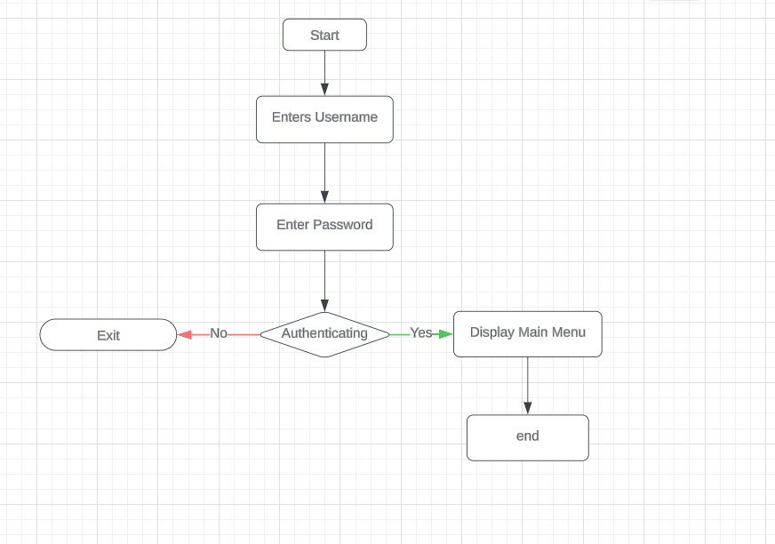
Authentication Flow

Slide 14
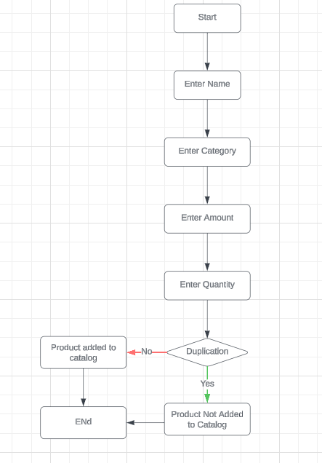
Add Product Flow

Slide 15
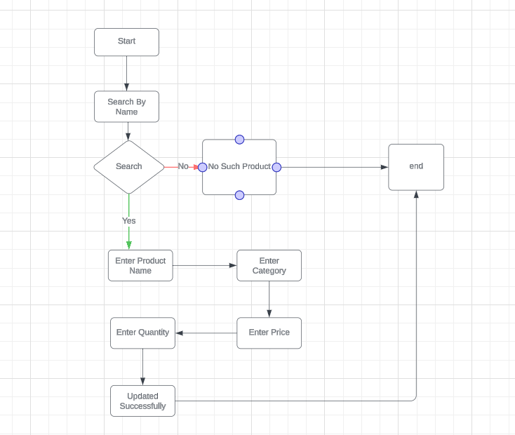
Update Product Flow

Slide 16
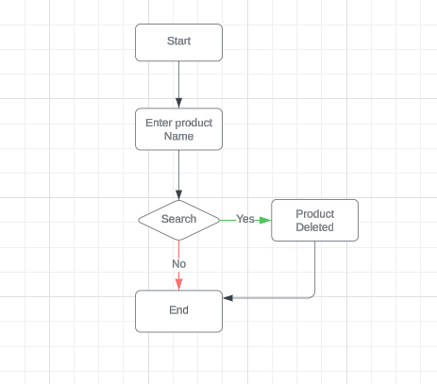
Delete Product Flow

Slide 17
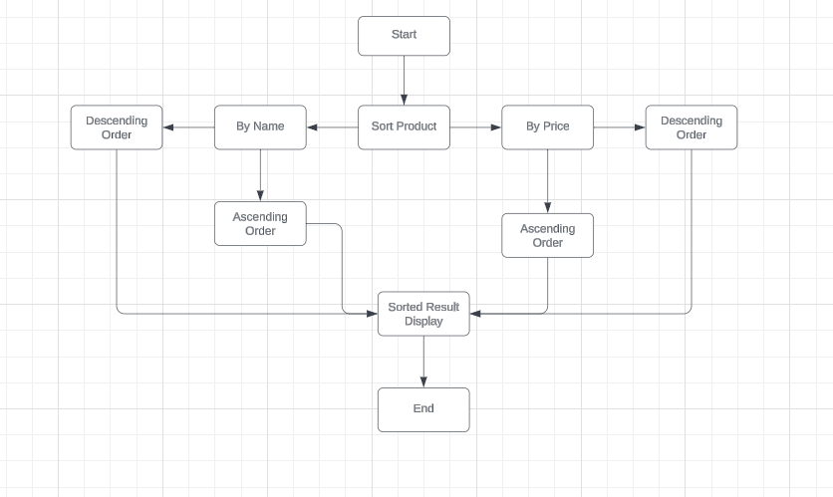
Sort Product Flow

Slide 18
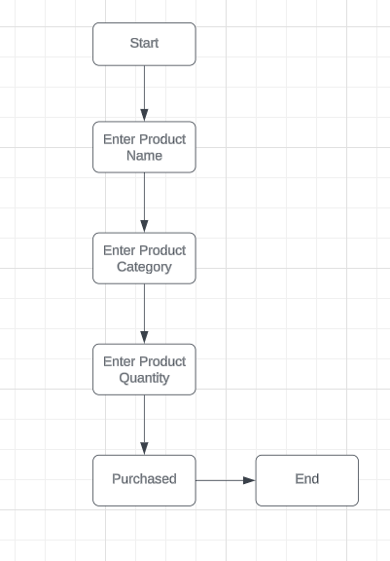
Purchase Product Flow

Slide 19
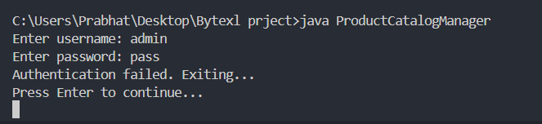

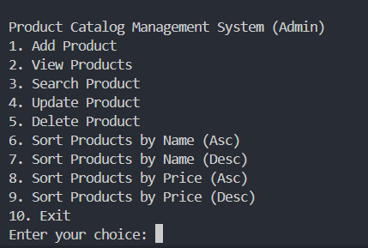
Sample I/O
Admin Auth Failed
Admin Auth Successful

Slide 20
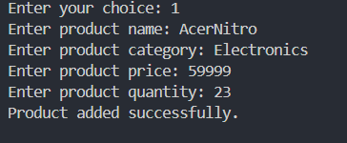
Sample I/O (Add Product)

Slide 21
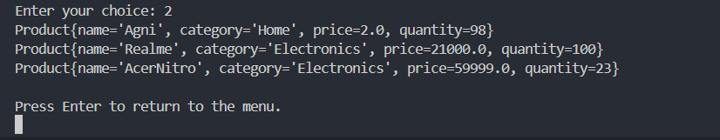
Sample I/O (View Product)

Slide 22
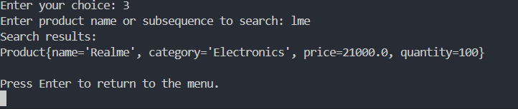
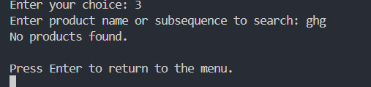
Sample I/O (Search Product)
Found
Not Found

Slide 23
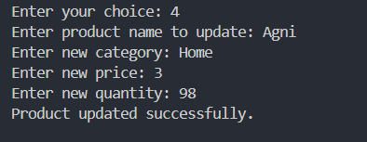
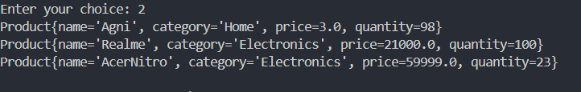
Sample I/O (Update Product)

Slide 24

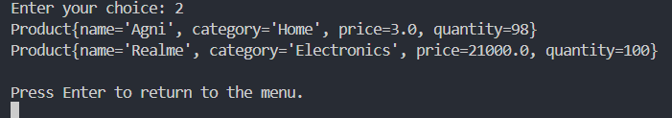
Sample I/O (Delete Product)

Slide 25
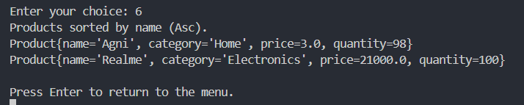
Sample I/O (Sort Product(name) - ASC)

Slide 26
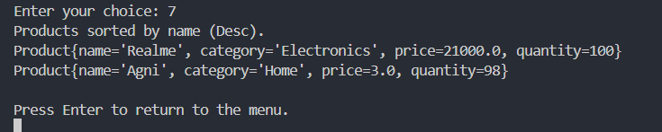
Sample I/O (Sort Product(name) - DSC)

Slide 27
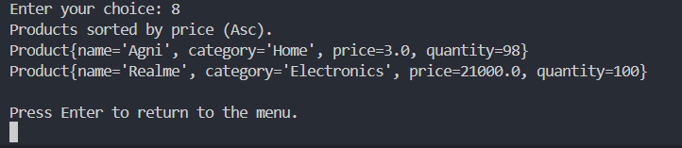
Sample I/O (Sort Product(price) - ASC)

Slide 28
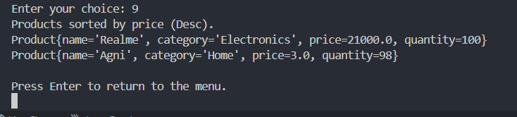
Sample I/O (Sort Product(price) - DSC)

Slide 29
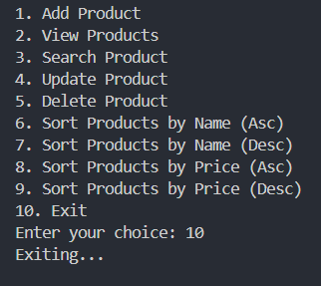
Sample I/O Exiting

Slide 30
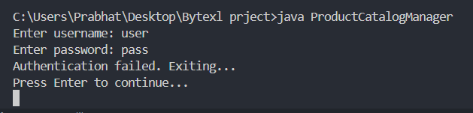

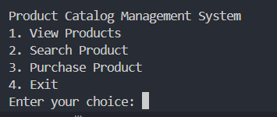
Sample I/O (User Login)
Login Failed
Login Successful

Slide 31
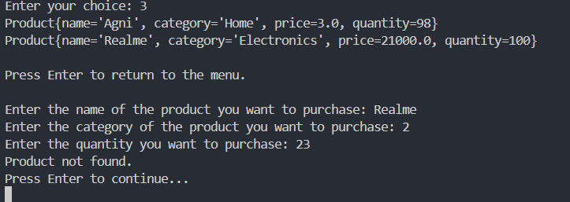
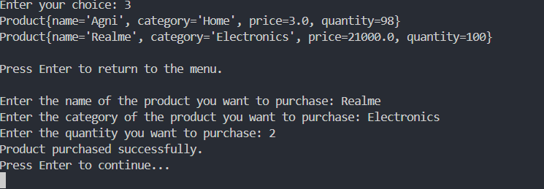
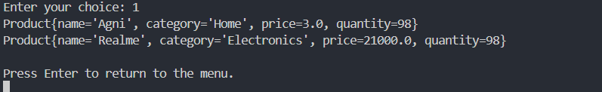
Sample I/O Purchasing
Product Not found
Purchased successfully

Slide 32
Summary
Overview
The Product Catalog Management System is a console-based application developed in Core Java. It allows users to manage a catalog of products, including adding, viewing, updating, searching, sorting, deleting products, and simulating purchases. The system supports authentication, differentiating between administrators and regular users, with specific functionalities accessible based on user roles.

Slide 33
Key Features
File Handling:
Product data is stored in a file, ensuring data persistence. Upon restarting the program, the catalog is loaded from the file.
Error Handling:
The system includes robust error handling, providing user-friendly messages and preventing unexpected crashes.

Slide 34
Workflow
Startup: The application starts and prompts the user for authentication.
Menu Display: Based on the user's role (admin or regular user), the appropriate menu is displayed.
User Input Handling: The application handles user input to perform various actions such as adding, viewing, updating, deleting, searching, sorting products, or simulating a purchase.
Persistent Storage: Product data is saved to a file after any modification and loaded from the file at startup.
Error Handling and Messaging: The application provides informative messages and pauses to allow the user to read messages.

Slide 35
Conclusion
The Product Catalog Management System is a robust and user-friendly application for managing products. It incorporates essential functionalities required for catalog management, ensures data persistence, provides a secure environment with user authentication, and offers a seamless user experience with error handling and messaging features.

Slide 36
Bibliography
1. Java Official Documentation
- Java SE Documentation:
https://docs.oracle.com/en/java/javase/index.html
2. File Handling in Java (Oracle Tutorials):
Basic I/O: https://docs.oracle.com/javase/tutorial/essential/io/
Reading, Writing, and Creating Files: https://docs.oracle.com/javase/tutorial/essential/io/file.html

Slide 37
Bibliography
3. Console-based Application Tutorials (Oracle):
- The Java Tutorials - Basic I/O - Command-Line Arguments:
https://docs.oracle.com/javase/tutorial/essential/io/cl.html
Scanning and Formatting: https://docs.oracle.com/javase/tutorial/essential/io/scanning.html
4. Flowchart Creation Tools:
- Lucidchart (Online flowchart tool): https://www.lucidchart.com/pages/

Slide 38
Thank You

